Slide 1
Introduction to Data Structures & Algorithms
Lecture 01

Slide 2
Objectives
What is data structure?
Basic types of data structure
What is algorithm?
Data structures and Algorithms

Slide 3
What is data structure (DS)?
It’s a way of storing data in a computer so it can be used efficiently.
A way of organizing data considers not only the items stored, but also their relationship to each other.

Slide 4
Why data structure (DS)?
Knowledge about relationship between data items allows designing of efficient algorithms for manipulation of items.
Careful chosen DS will allow more efficient algorithms
Choice of DS often begins with the choice of an abstract data structure.
Well designed DS allows variety of critical operations to be performed on using a little resources (execution time, memory spaces, etc)
Different DS(s) suited for different applications, some are highly specialized e.g., B-trees is god for databases, hash tables is good for compiler to lookup identifiers.

Slide 5
Why DS is important in Computer Science
DS is used in most programs
DS provides a means to manage huge amounts of data efficiently
databases, internet indexing services, etc
Efficient DS(s) are the key to designing efficient algorithms.
Some formal design methods and programming languages emphasize DS(s) rather than algorithms
key organizing factor of software design
Algorithms + Data Structures = Programs

Slide 6
Basic Types of DS(s)
Files
Lists
Arrays
Records
Trees
Tables

Slide 7
What is an algorithm?
Formula or set of steps for solving a particular problem.
To be an algorithm, a set of rules must be unambiguous and have a clear stopping point.
Algorithms can be expressed in any language, from natural languages to programming languages
We use algorithms every day. E.g., a recipe for baking a cake is an algorithm
Most programs consist of algorithms
Inventing elegant algorithms – should be simple and fewest steps possible – is challenges in programming

Slide 8
Algorithm example
Recipe
CHOCOLATE CAKE
4 oz. chocolate 3 eggs
1 cup butter 1 tsp. vanilla
2 cups sugar 1 cup flour
Melt chocolate and butter. Stir sugar into melted chocolate. Stir in eggs and vanilla. Mix in flour. Spread mix in greased pan. Bake at 350º for 40 minutes or until inserted form comes out almost clean. Cool in pan before eating
Program Code
Declare variables
chocolate eggs mix
butter vanilla
Sugar flour
mix = melted ((4*chocolate)) + butter)
mix = stir(mix + (2*sugar))
mix = stir(mx + (3*eggs) + vanilla)
mix = mix + flour
spread(mix)
while not clean (fork)
bake(mix, 350)
Mix ingredients
Spread in Pan
Remove from Oven
Bake at 350⁰
Let Cool
Not
Ready
Ready
Test with fork
Eat

Slide 9
Properties of an algorithm
Input – an algorithm accepts zero or more inputs
Output – it produces at least one output
Finiteness – it terminates after a finite steps
Definiteness – each step in algorithm is un ambiguous. Means can be interpreted in one way only and can be performed without any confusion
Effectiveness – it consists basic, realizable instructions. Means Instructions can be performed using given input in a finite amount of resources (time, space)
Generality – it must work for a general set of inputs

Slide 10
How to represent algorithms?
Use natural languages
Too verbose
Too “context-sensitive” – relies on experience of reader
Use formal programming languages
Too low level
Requires us to deal with complicated syntax of programming language
Use Pseudo-code (alias programming language)
natural language constructs modeled to look like statements available in many programming languages
Use Flowchart (diagram)
A flowchart can represent algorithms or process, showing steps as boxes of various kinds, order by connecting arrows.
Flowchart is used in analyzing, designing, documenting or managing a process or program in various fields

Slide 11
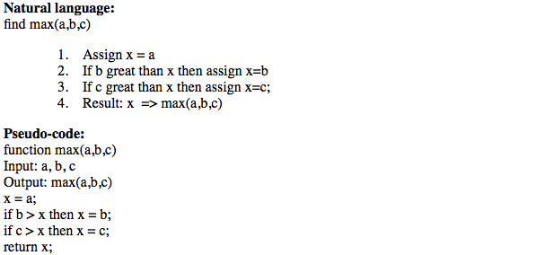
Algorithm representation examples
Problem: find the greatest of three numbers

Slide 12
Algorithm representation examples
Flowchart
Begin
x:=a
b>x
true
x:=b
false
false
c>x
true
end
x:=c
What does this algorithm do?

Slide 13
Data Structures and Algorithms
Most algorithms operate on data collections, so define
Collection Abstract Data Type (ADT)
Methods
Constructor/Destructor
Add/Delete
Find
Sort
…

Slide 14
Summaries
What is data structure?
Basic types of data structure
What is algorithm?
Data structures and Algorithms

